Slide 1


Generative AI for Cyber Threat-Hunting in 6G-enabled IoT Networks
Presented by: Team-G628
Name: B Govardhan
Roll No: 23P81A0578
Guide: G Keerthi

Slide 2

Project Overview:
This project builds a GAN + Transformer–based cyber threat-hunting system for 6G-enabled IoT networks. GANs generate synthetic attack data to balance the dataset, and a Transformer model classifies IoT attacks with high accuracy. Using the Edge-IIOT dataset, the system achieves good accuracy in identifying 14 different attack types. The approach improves real-time threat detection in large, high-speed 6G IoT environments while addressing challenges such as scalability, data quality, privacy, and energy consumption.

Slide 3
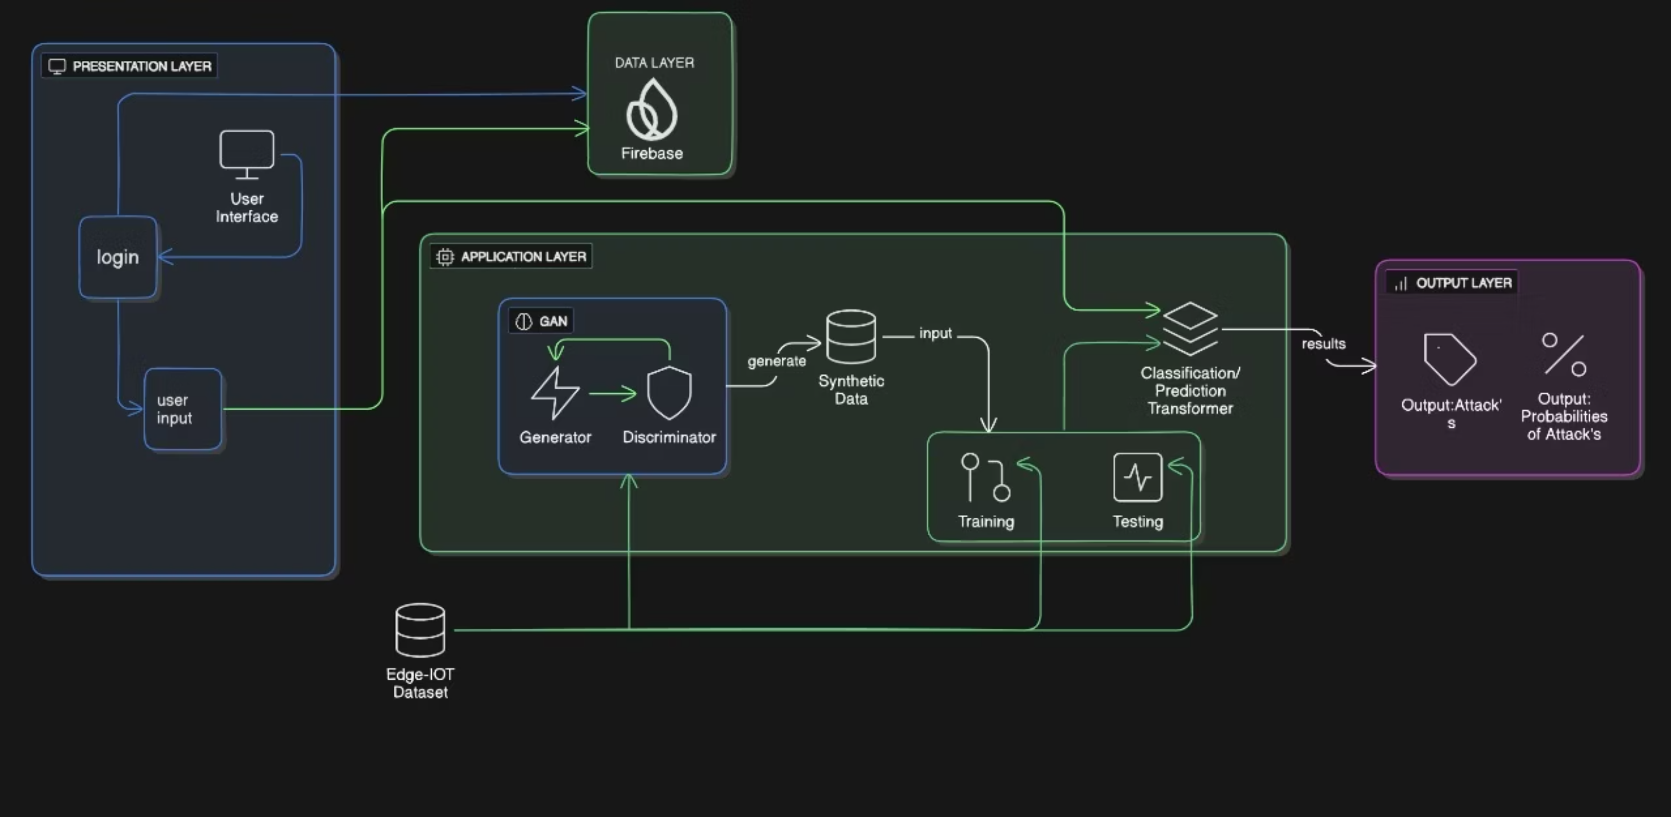
System Architecture:

Slide 4
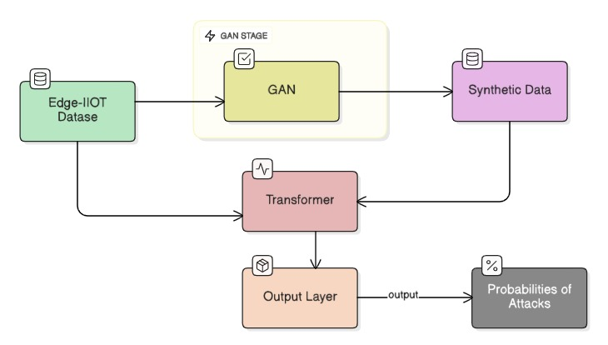
Data Flow between modules:

Slide 5

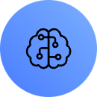
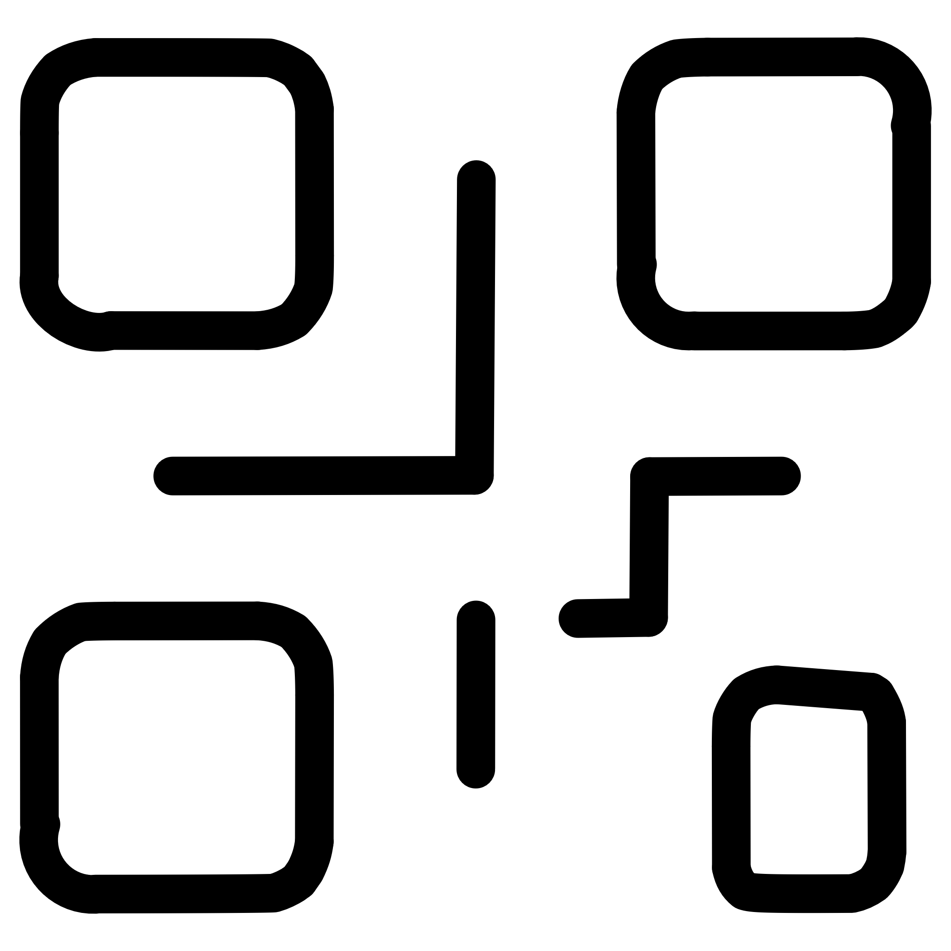
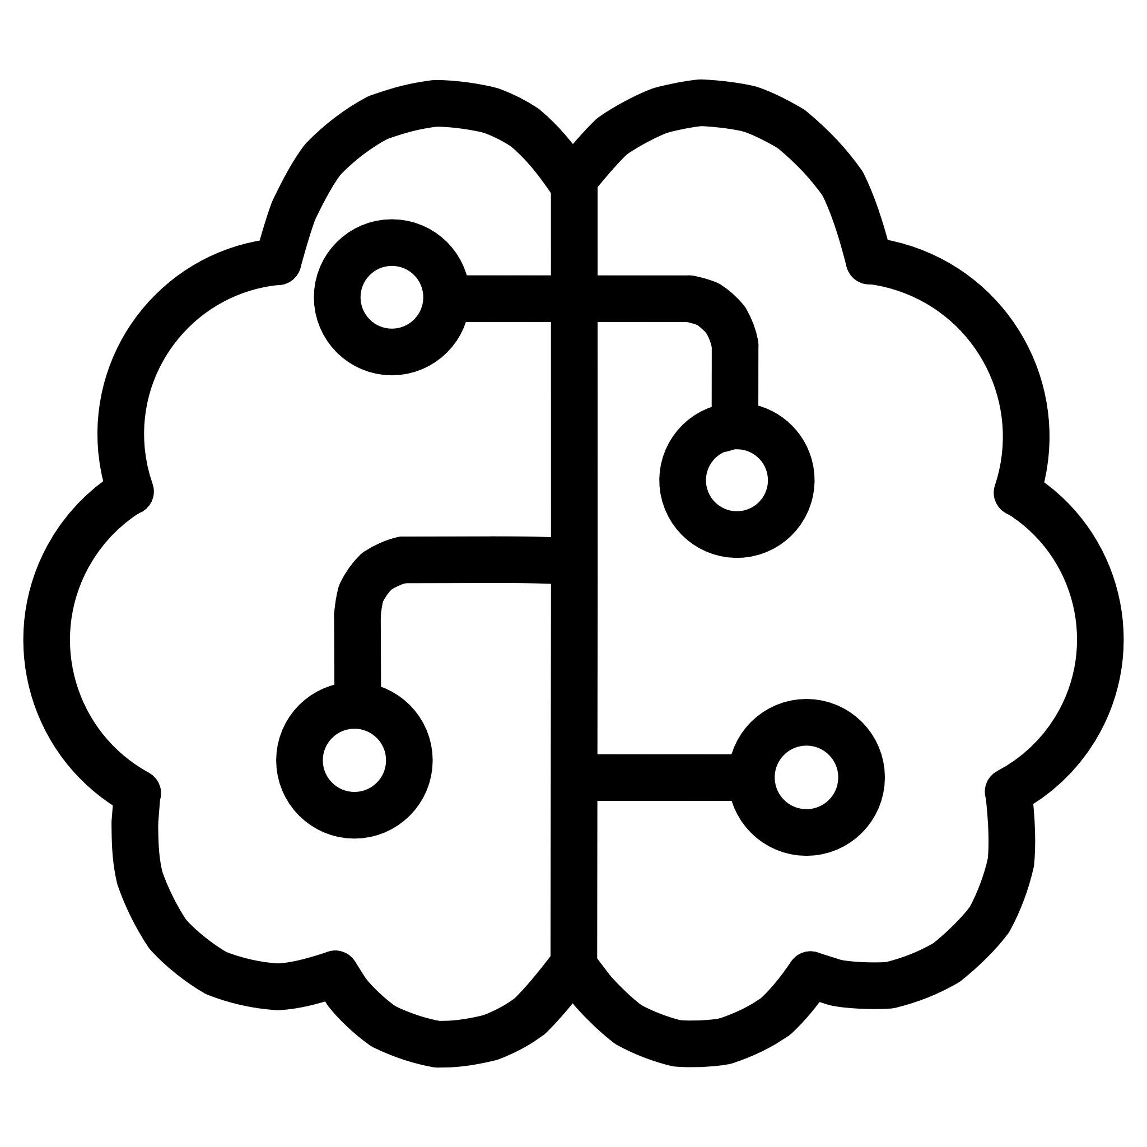
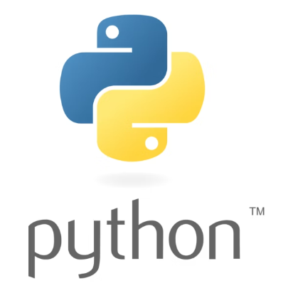







Technology Stack & Development:
Programming Languages
ML/DL Frameworks
TensorFlow
scikit-learn
Pandas
NumPy
Pickle
Development Tools
Database & Deployment
Netlify
railway

Slide 6

Mathematical Foundation
Core Mathematical Formulas
Discriminator Loss: L(D) = −(log(D(x)) + log(1 − D(G(z))))
Generator Loss: L(G) = −log(D(G(z)))
Transformer:
Scaled dot-product attention: Att(Q,K,V)= softmax(QK^T/√d_k)V
Multi-Head Attention mechanism: MultiHead(Q,K,V)=Concat(h1​,…,h_h​)W^O
Feed-Forward Network (FFN): FFN(x)=max(0,xW1​+b1​)W2​+b2​
F1-Score (Model Evaluation): F1=(2⋅Precision⋅Recall​ / Precision + Recall)
Key Model Parameters:
Learning rate: 0.001
Batch size: 64
Activation: ReLU( in hidden layers) and Softmax(in output layer)

Slide 7
Achievements, Challenges & Future Directions
Key learnings:
Potential improvements:
Real-world applications:
How GAN synthetic data will help to the Transformer
Use advanced GANs for synthetic data
Smart Home Devices
Integrate graph-based modeling
Industrial IoT (IIoT) / Smart Manufacturing
How to collect data from IOT devices
Expand dataset with additional real-world attacks
Smart Healthcare Systems
Comparison with paper's results:
Performance analysis:
Challenges faced:
Good Accuracy on real test data
Imbalanced dataset
Architecture :GAN + Transformer
cGAN + Transformer
Dataset: Edge-IIoT (61 feats, 15 cls) Edge-IIoT (47 feats, 15 cls)
GAN Purpose: Data Augmentation Class-balanced cGAN
Model: Transformer Tabular Transformer
Loss: Low and stable → good convergence
Efficiency: Moderate training time; best with GPU
Noisy / redundant logs
Many features (60+)
Limitations:
• Little complex to detect rare attacks
• Noice in GAN synthetic data
• you can only monitor recent 5 IOT devices

